Slide 1
Machine Learning
Machine Learning Introduction to Machine Learning by Kumar Anurupam is licensed under a Creative Commons Attribution-4.0 International License.
Artificial Neural Networks – CNN - III
CS 3104 Fall 2019
Lecture Slides by Kumar Anurupam

Slide 2
Learning Objectives
After completion of today’s session you will be able to:
Illustrate the concept of convolution layer.
Analyze the similarities between MLP and CNN.
Describe the steps for generating outputs in CNN.

Slide 3
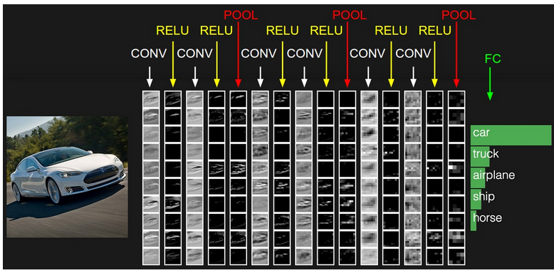
Convolutional layer
Image source: http://cs231n.github.io/convolutional-networks/

Slide 4
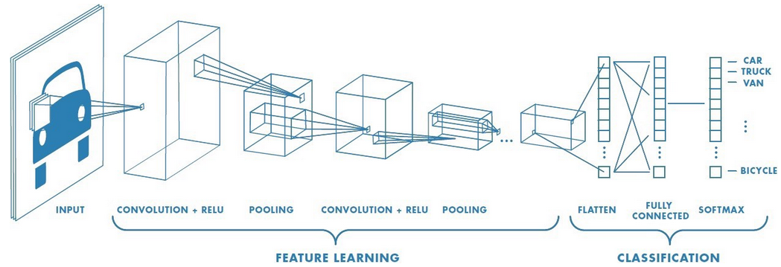
CNN

Slide 5
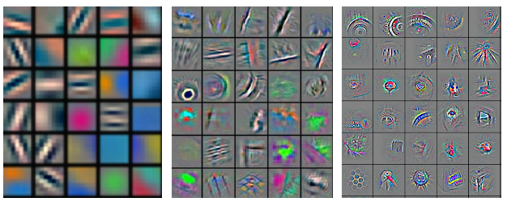
Kernel learning

Slide 6
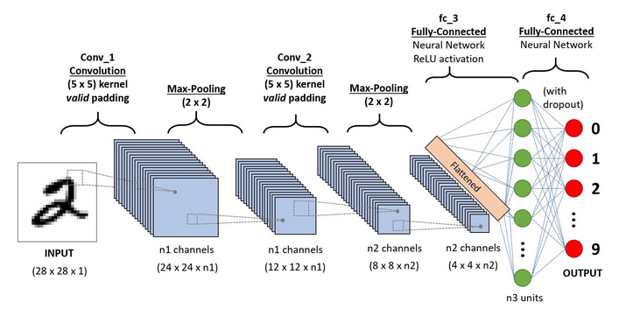
CNN sequence to classify handwritten images

Slide 7
References
[1]http://cs231n.github.io/convolutional-networks/
[2] https://towardsdatascience.com/a-comprehensive-guide-to-convolutional-neural-networks-the-eli5-way-3bd2b1164a53
[3]https://stats.stackexchange.com/questions/362988/in-cnn-do-we-have-learn-kernel-values-at-every-convolution-layer

Slide 8
Thanks

